Slide 1
Incedo Lite Product
User manual and technical presentation
V040521

Slide 2
Features
Incedo™ Lite
Database Type: Embedded
Number of Doors: 32
Wired & Aperio On-Line readers
Number of Keyholders: 1,000
Door Modes
Time Profiles
Anti Passback
Emergency Lockdown
Emergency Unlock
V040521
Notes:
Part Numbers – created for all 7 parts (may require additional for bundles with readers)
Pricing – calculations have been completed for Hardware and Readers and awaiting sign off before releasing
Regional Price list with suggested discount structure to be created
Beta Site due to be installed W/C 4th November for Embedded Solution with the Aperio integration being added in December and Cloud following – we have permission to use this for a cast study
Demo equipment to be ordered for the 4 regions in November once the rebranding exercise has been completed
Each region will be provided with a controller, reader module(s) and readers
Copy of the Professional software
Log in to the Cloud when available
Note: Training will be provided when handing the equipment over
Plan for control of Professional software needs to be created to protect the regions

Slide 3
Hardware
Incedo™ Lite
The Incedo Lite Access Control System is made up of two core parts – the Cluster Controller & a Reader module. Each system will require at minimum of one Cluster Controller.
These two parts are available in the following variants.
Metal enclosure
Boxed Controller including Cluster Controller, Reader Module, PSU (ROHS/5Amp), Metal enclosure c/w tamper and battery charging circuit
Reader Module, IPS back plate - Boxed Controller Expansion Option
Plastic housing
Cluster Controller, Plastic housing
Reader Module, Plastic housing
V040521

Slide 4
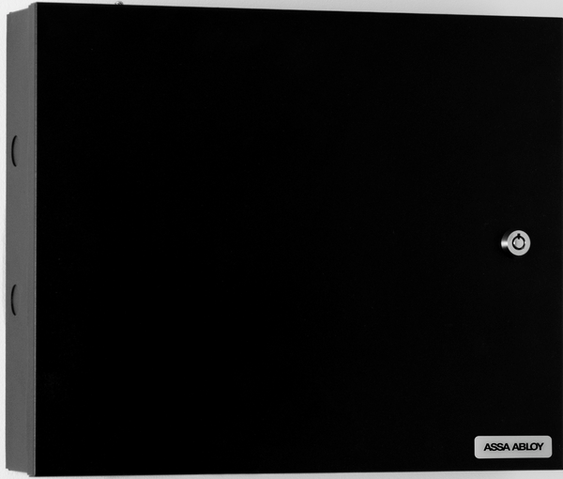
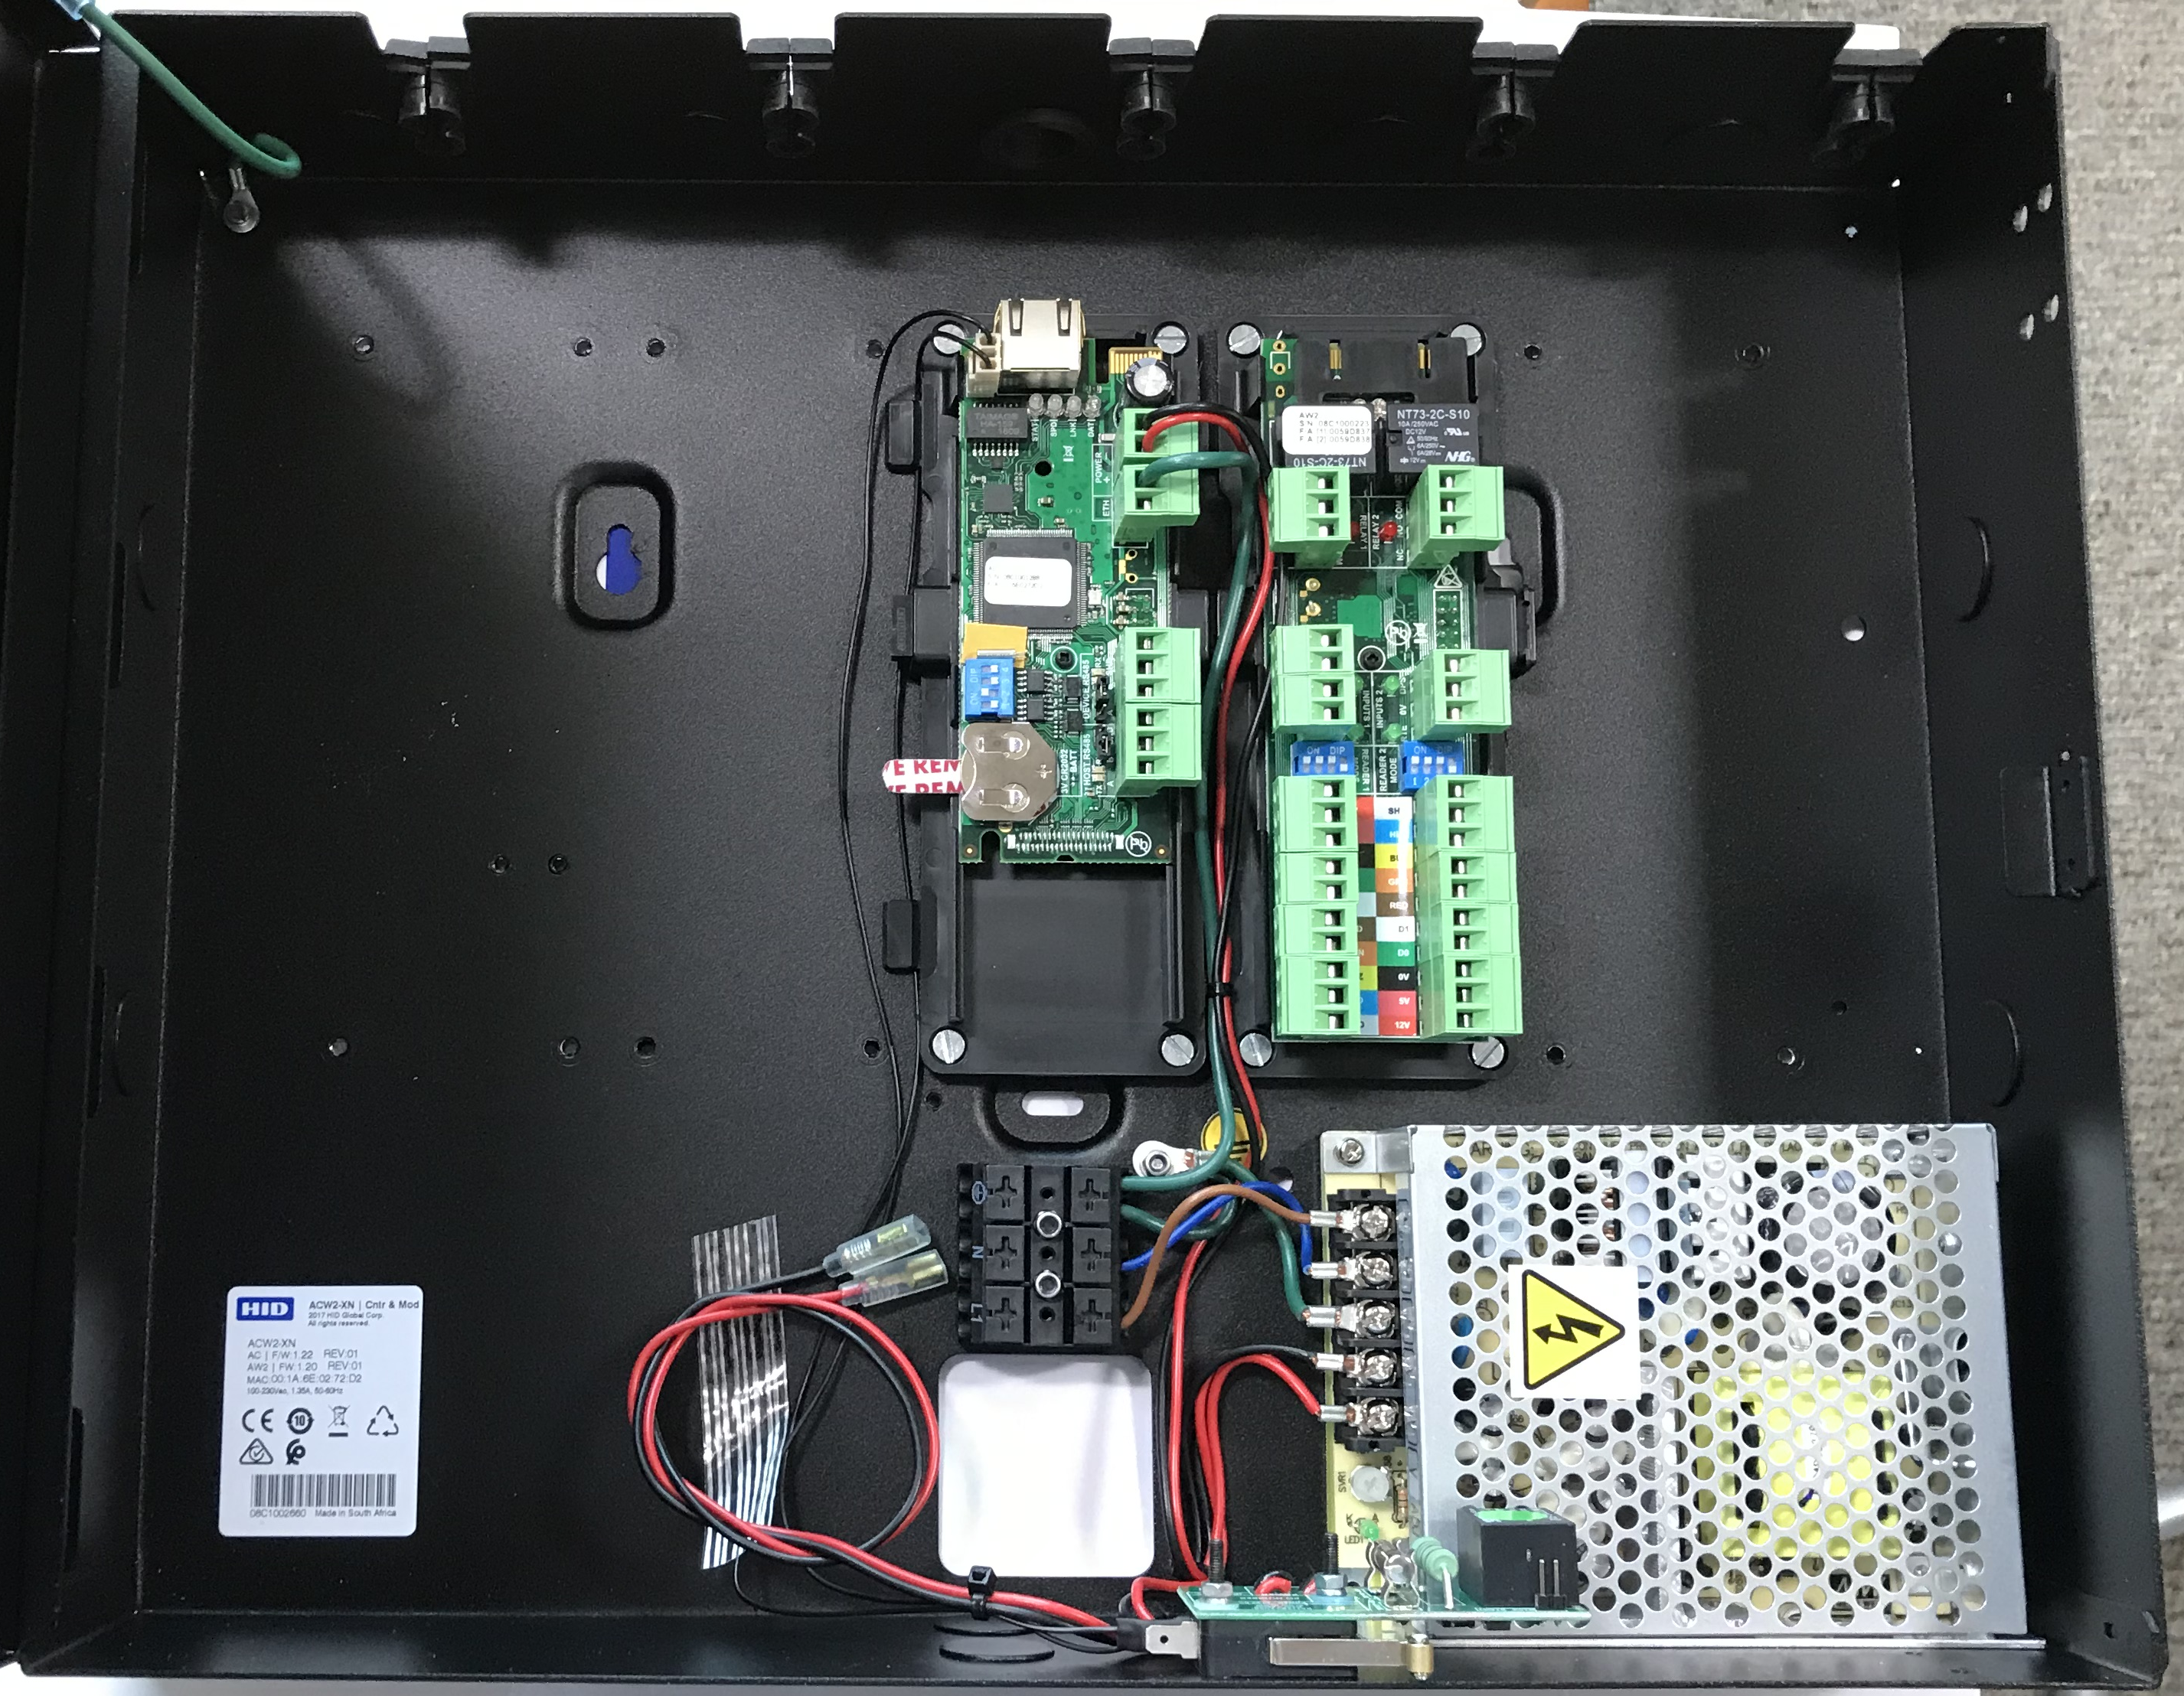
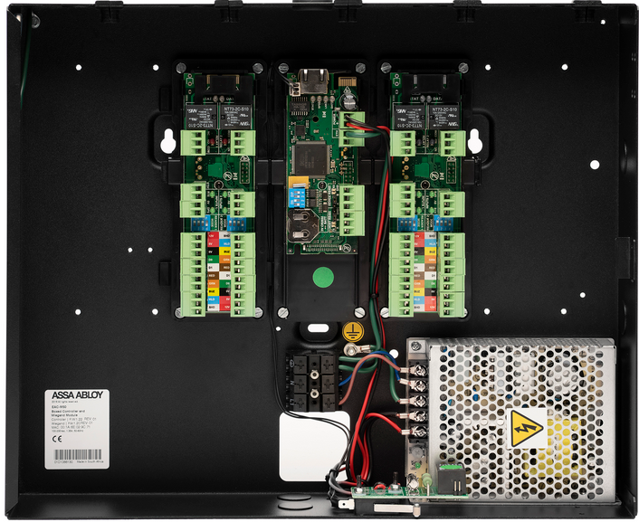
Incedo™ Lite
Metal Enclosure with PSU
The Metal Enclosure comes with a Cluster Controller, a Reader module and PSU.
The Enclosure is expandable up to 4 reader modules allowing a total of 8 doors or 4 doors with in and out readers.
An additional 12V 7Ah Lead-Acid Battery can be added in case of power failure.
Boxed Controller c/w 1 Reader Module c/w 2 Reader Modules
V040521

Slide 5
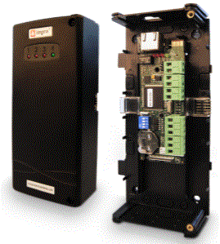
Incedo™ Lite
Plastic Housing
The Plastic housing version of the Controller is the same as in the Metal Enclosure version only mounted in a Plastic, it does not include a reader module or PSU, these items must be purchased separately.
Controller in Plastic housing with lid removed
*Note. The Plastic housing modules are not designed to be mounted in a Metal Enclosure.
V040521

Slide 6
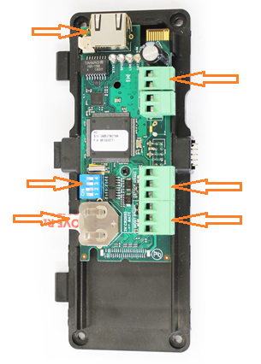
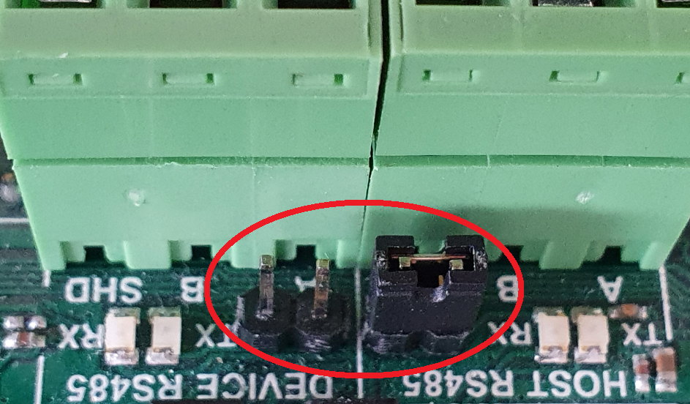
Incedo™ Lite
Cluster Controller
Line termination links
RJ45 Network connection.
12V DC Power
Configuration dip switches.
Master = dip switch 2 ON
Slave = dip switch all OFF
Device RS485 to Slave Controller
*Battery Tag
(remove before connecting power)
Host RS485 to Aperio Hubs
*Power Cycle of the controller when the Battery is not connected or when Flat will result in the System data being removed from the controller.
Battery Type ........................... 1 x 3 V, CR2032, Lithium cell Battery.
Battery Life ............................. 1 Year with Power OFF,
5 years with Power ON,
5 years Storage with Battery Tab in place.
Line termination links
V040521

Slide 7
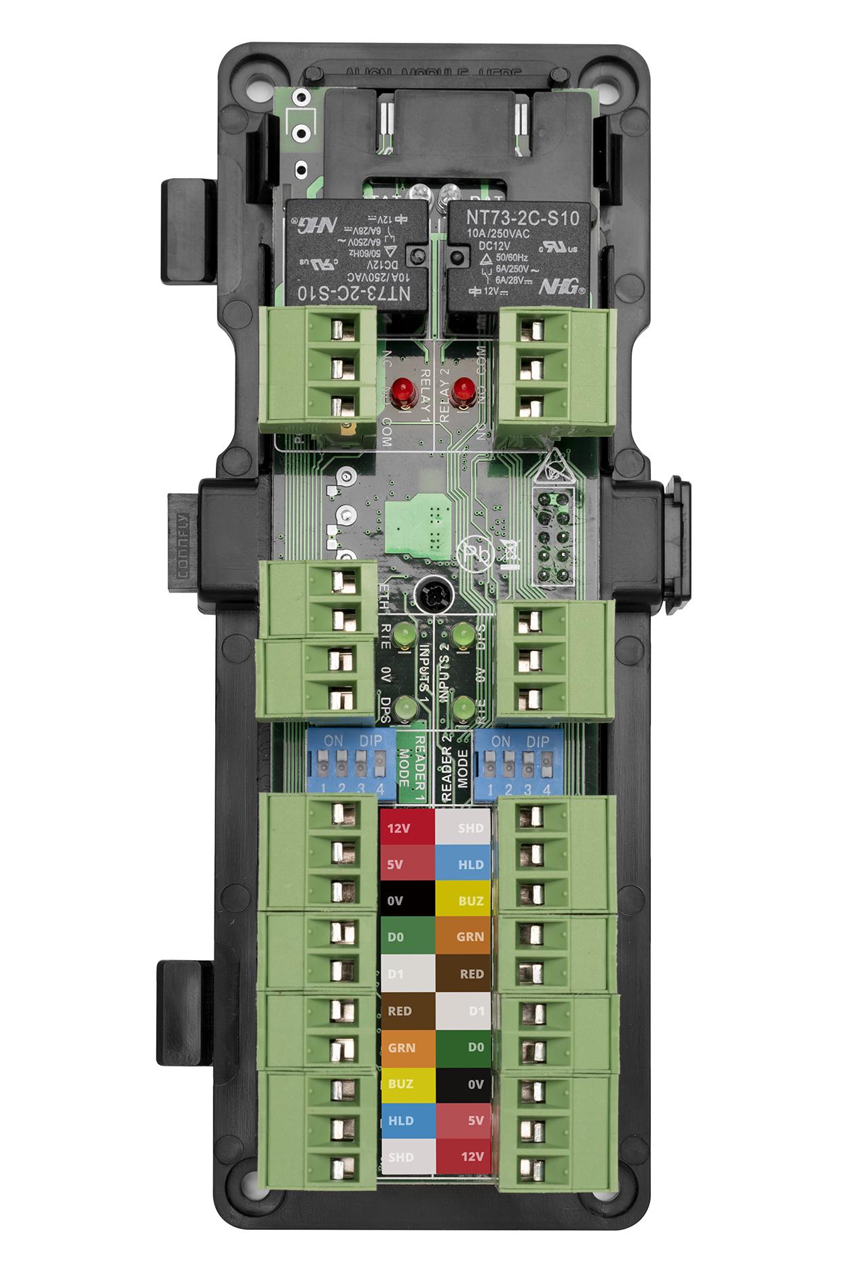
Incedo™ Lite
Reader Module
Two versions available
Reader Module, IPS back plate - Boxed Controller Expansion Option.
Reader Module, Plastic housing - External Expansion
The image shown is the boxed controller version. The plastic mounting differs between the Boxed Controller and Plastic housing version, the PCB stays the same.
Door Connections
Suitable for one door with an IN and OUT reader or two doors with an IN reader only.
Lock output relay. N.O. (Fail Secure) or N.C. (Fail Safe) connections.
Input - Door Position Sensor
Input – Request to Exit
Reader configuration Dip Switch. Default 1 2 3 ON 4 OFF.
Wiegand Reader connection. ASSA ABLOY Pigtail colour coded connections
Up to 4 Reader Modules can be attached to a single Controller
V040521

Slide 8
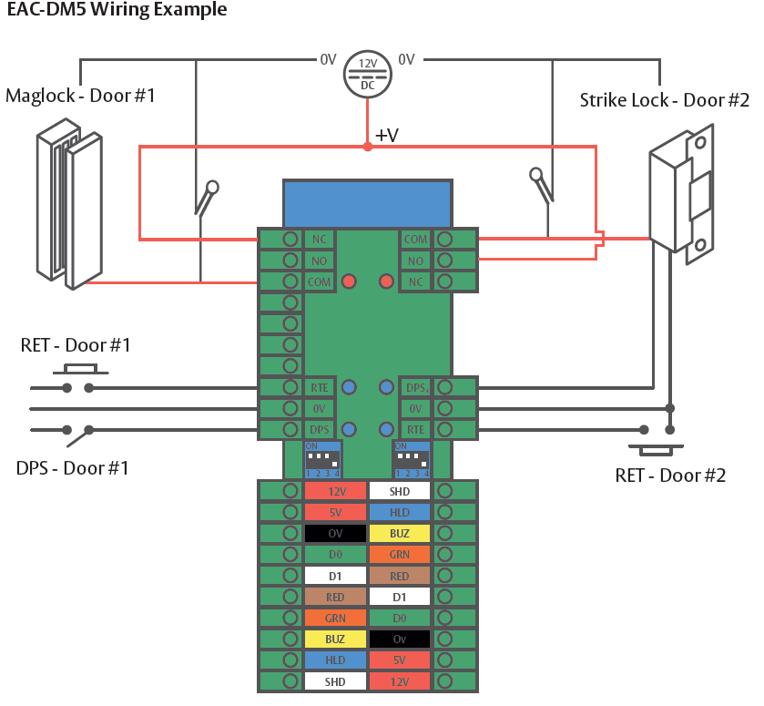
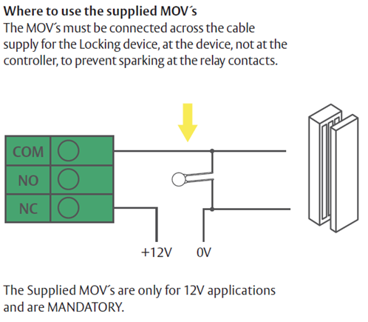

Lock Installation
Incedo™ Lite
Install the MOV as close to the lock as possible.
V040521

Slide 9
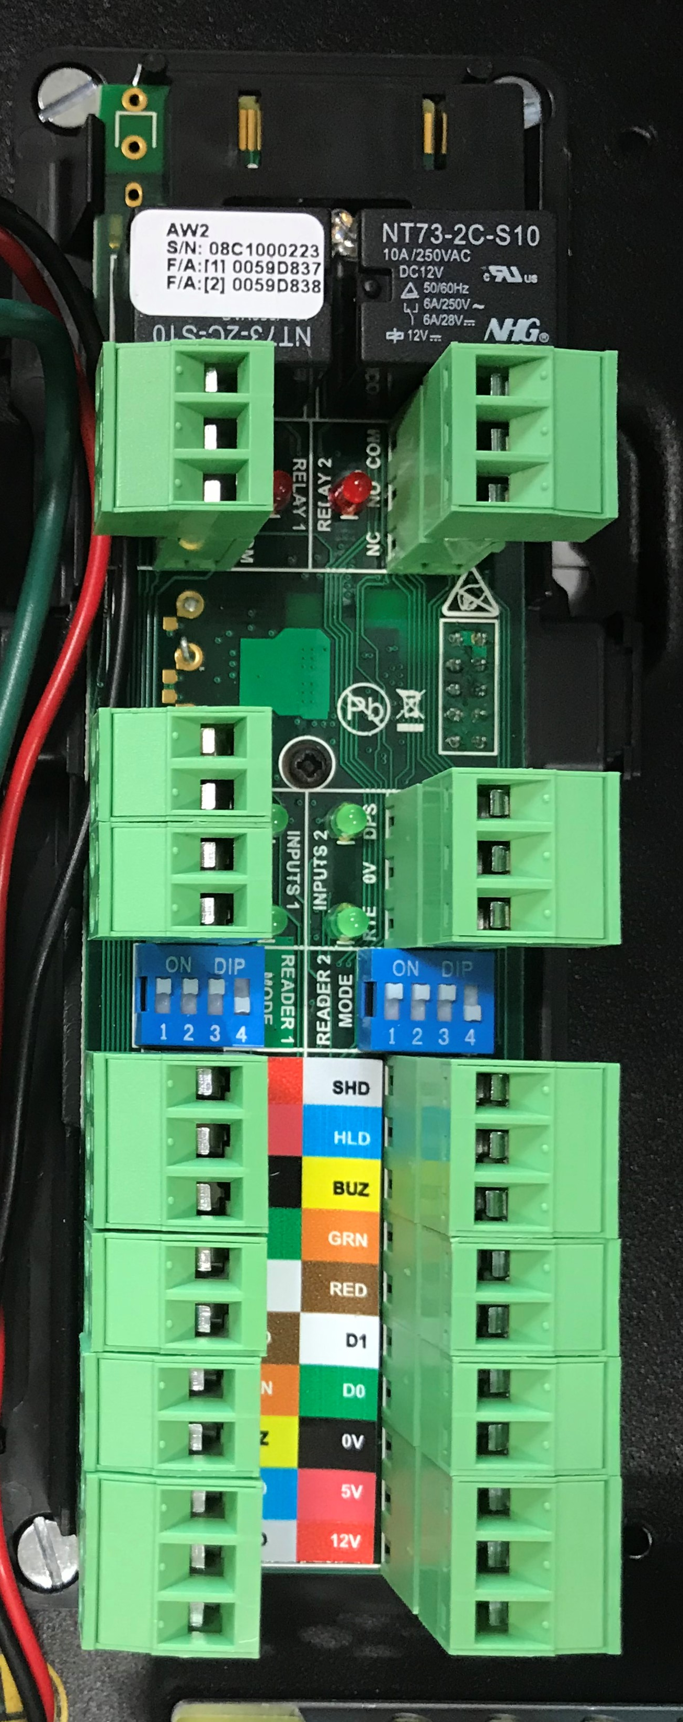
Incedo™ Lite
Architecture for system with over 8 wired doors
When the number of doors exceeds 8 (4 doors with IN/OUT readers) the system can be expanded by adding additional Cluster Controllers to the “Master” Cluster Controller via a standard RS485 bus*. Each Slave Cluster Controller can handle an additional 4 Reader modules and could be either the metal enclosure or plastic housing depending on the site requirements.
This flexibility allows the system to be design to meet the sites needs without any lose of functionality. Master and Slave Controllers are connected using the Device RS485 connection*.
Master Cluster Controller
Slave Cluster Controller
Slave Cluster Controller
Slave Cluster Controller
RS485
In
Out
In
Out
In
Out
A
B
Max length 1,000m
Slave Cluster Controller(s)
SHD
*Standard RS485 rules apply in terms of cable distance and the use of belden cable with 3 conductors available.
*Apply Line termination to the Master Controller and the last Slave Controller on the RS485 bus. See Slide 6.
V040521

Slide 10
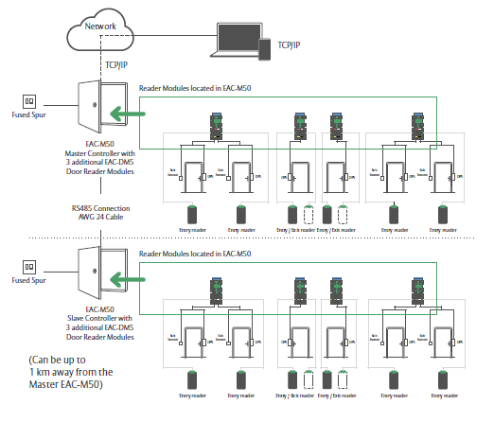
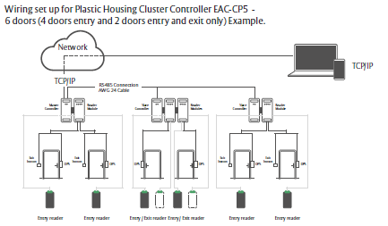
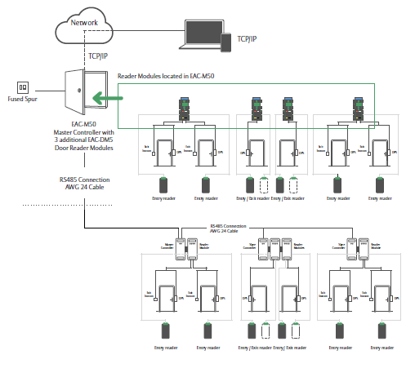
Incedo™ Lite
Wiring Consideration
The configuration of Incedo is flexible allowing you to install the equipment that is best suited to the application – The system can be installed in a central location running cables to each door, local to each door with a controller and reader module or a combination of both
Option A – Install a Metal Controller in a central point and run the door cables out
Option B – Install Plastic Controller and Reader Module local to the door and connect controllers via RS485
Option C – A combination of options A and B.
V040521

Slide 11
Incedo™ Lite
Cluster Controller
Only the Master Cluster Controller is connected to the Customers Network
Network Configuration options for the Controller are DHCP or Static IP
Only the Master Cluster Controller can be connected to the Aperio RS485 bus
Up to 4 Reader Modules can be connected to a controller, Master or Slave, allowing 4 doors read IN/OUT or 8 doors read IN
Incedo Lite can be configured to manage up to 32 doors (16 doors with IN/OUT readers)
A combination of Wired and Aperio readers can be installed. Combined maximum 32 readers
Slave controllers will run independently if the Master Controller fails
Additional reader modules can be added without powering down the controller allowing uninterrupted use of the system during maintenance
V040521

Slide 12

Incedo™ Lite
Aperio Doors
Aperio Hubs can only be connected to the RS485 Bus on the Master Controller
Aperio Hubs are connected to the Host RS485 connection
Up to 8 Aperio readers can be paired with an Aperio AH30 Hub
A maximum of 32 Aperio readers can be installed
A maximum of 8 Hubs can be attached to the RS485 Bus
The number of available Aperio doors is reduced by the total number of wired readers attached to the system. Example. If there are 4 wired readers then the number of available doors for use with Aperio is 28
Each Hub requires a Unique address set via dip switch
The RS485 bus requires termination at both ends. The Master controller (see slide 6) and the last Aperio Hub - set via dip switch on the last Hub on the Bus (slide 13 & 14)
Commissioning Aperio devices requires a USB wireless programming dongle, commissioning software and unique Encryption key
V040521

Slide 13
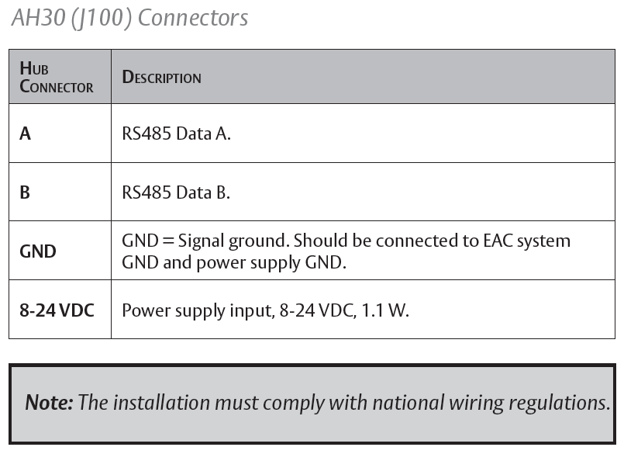
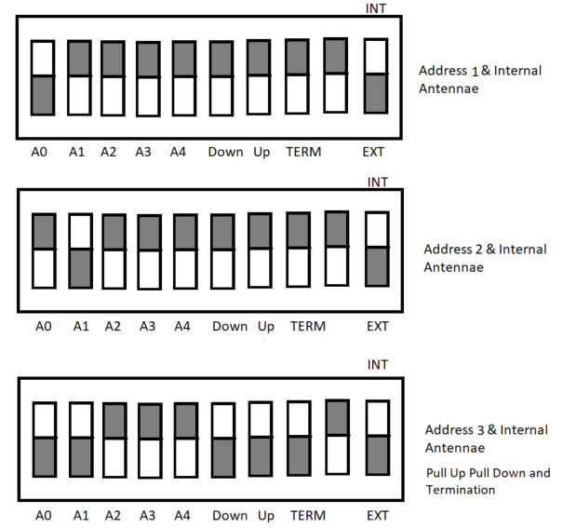
Incedo™ Lite
Aperio Wiring and Dip Switch settings
Connect the AH30 Aperio Hub to the RS485 Host connector on the Master Controller.
Aperio Hubs are connected to the Master Controller only and cannot be connect to a Slave Controller.
Each Hub requires a unique address set using dip switches 1 to 4. Binary addressing dip 1 = address 1, 2 = address 2, 1 & 2 = address 3 etc.
The last hub on the 485 bus requires Pull Up and Pull down resistors and termination set using dip switches 6, 7 and 8
Apply Line termination to the Master Controller for the Host connection on the RS485 bus. See Slide 6.
V040521

Slide 14
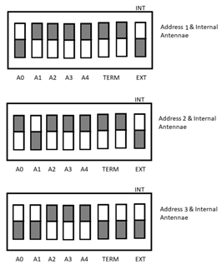
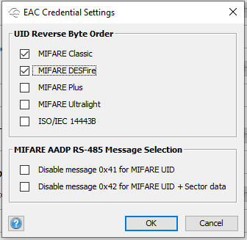
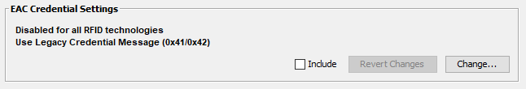
Incedo™ Lite
Aperio AH30 Gen5 Hub Configuration
Connect the AH30 Aperio Hub to the RS485 Host connector on the Master Controller.
Aperio Hubs are connected to the Master Controller only and cannot be connect to a Slave Controller.
Each Hub requires a unique address set using dip switches 1 to 4. Binary addressing dip 1 = address 1, 2 = address 2, 1 & 2 = address 3 etc.
The last hub on the 485 bus requires termination, dip switches 6 and 7.
Apply Line termination to the Master Controller for the Host connection on the RS485 bus. See Slide 7.
Use the Aperio Programming application to set UID Revers Byte order for Mifare Credentials.
V040521

Slide 15
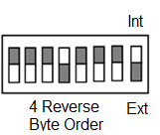
Incedo™ Lite
Aperio AH20 Wiegand Gen5 Hub Configuration
Connect the AH20 Aperio Hub to a Weigand module reader connector. Using 8-24v DC, Gnd, Green LED, Red LED, D0 and D1.
Hub dip switch setting 4 ON (reverse Byte order)
Alternate to Dip Switch 4 setting.
Use the Aperio Programming application to set UID Revers Byte order for Mifare Credentials.
V040521

Slide 16
Incedo™ Lite
Card Format
iCLASS
H10301 26bit, H10302 37bit, H10304 37bit, Corporate 1000 37bit and 48bit.
  Facility code can be enabled for all except the H10302 format.
  The Default format will be iClass H10302. Cards will be available to purchase with the system.
MIFARE
Classic, MIFARE DESFire EV1 (Mifare DESFire CSN limited to 32bit)
Custom Formats
It is possible to setup a custom card mask defining Parity, Ficility Code and Card Number
V040521

Slide 17
Incedo™ Lite
Configuration
Incedo does not require a host PC or Server.
There is no requirement for software installation.
Incedo Lite is an Embedded Solution accessed via a standard Web Browser
Compatible browsers Google Chrome, Mozilla Firefox, Microsoft Edge and Apple Safari
Access the system direct from a Laptop, PC or Mobile device.
Connect via a static IP address or DHCP.
V040521

Slide 18
Incedo™ Lite
Connecting for the First Time - DHCP
First Option: If you have a DHCP server
Type the following URL in to one of the supported browsers:- http:Incedo
You will be directed to the Incedo Lite login page
The default password is 12345
V040521

Slide 19
Incedo™ Lite
Connecting for the First Time using a Static IP
Second Option: Connect to the Cluster with a Static IP address.
Connect a PC/Laptop directly to the Controller network socket
Type the following IP address in to one of the supported browsers:- 192.168.100.1
You will be directed to the Incedo Lite login page
The default password is 12345
Configuring the systems Network settings see slide 26
To setup your PC/Laptop with a static IP address in the same range as the controller follow the steps on the next slide.
V040521

Slide 20
Incedo™ Lite
Configure your PC with a Static IP address
The Incedo Cluster Controller default IP address is 192.168.100.1
The PC needs a unique IP address in the same range as the controller. Not the same as the controller!
On the Windows PC from the Control Panel
Click Network and Internet followed by Network and Sharing Centre
Select Change adapter settings
Select the appropriate adapter e.g. “Local Area Connection” this will be the adapter the network cable is plugged into. If you are unsure disconnect the network cable and a red X will appear by the appropriate connector.
Right click on the adapter Icon and choose Properties
Double-click “Internet Protocol Version 4 (TCP/IPv4)”
Click “Use the following IP address”
Set the IP Address to 192.168.100.X (X being any available number between 2 and 254.
Set the Subnet Mask to 255.255.255.0.
Click the OK button
V040521

Slide 21
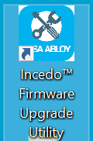
Incedo™ Lite
Firmware Upgrade Utility - Installation
To Install the Incedo Firmware Upgrade Utility
Double click the Incedo™ Firmware Upgrade Utility.exe
Select Language
Accept the License Agreement
If required tick Create desktop shortcut.
Confirm Install.
V040521

Slide 22
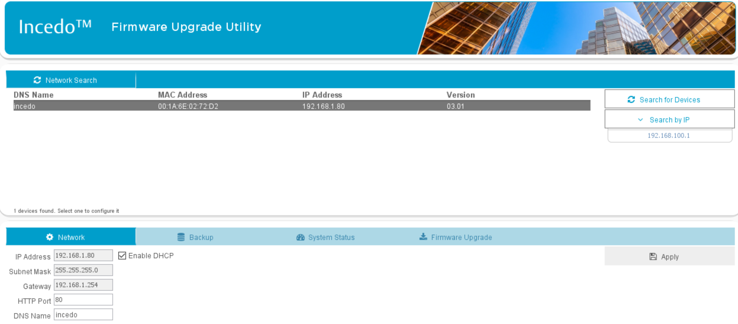
Incedo™ Lite
Firmware Upgrade Utility
The utility will auto discover the Incedo Cluster controller when connected via DHCP
Search by IP when using a Static IP address or the default 192.168.100.1
V040521

Slide 23


Incedo™ Lite
Firmware Upgrade Utility – Backup/Restore
It is recommended that a Backup is made before making any configuration changes or upgrading firmware in the Cluster Controller.
Select the Controller by clicking on the Device.
Choose the backup Tab.
Choose the Backup icon.
Select a location to store the backup.
To Restore a backup reverse the process.
*Note. It is important to ensure the customer is familiar with the backup process. It is the customers responsibility to ensure their data is adequately backed up and stored in a secure and safe location. The consequence of failing to secure the system will result in the reinstallation of all doors, users and credentials.
V040521

Slide 24

Incedo™ Lite
Firmware Upgrade Utility – Firmware Upgrade
Select the Controller by clicking on the Device.
Choose the Firmware Upgrade Tab.
Click Start Upgrade.
If you are reinstalling the same version of firmware or you attempting to roll back to an earlier version you will need to hold the CTRL key down when you click start upgrade.
V040521

Slide 25
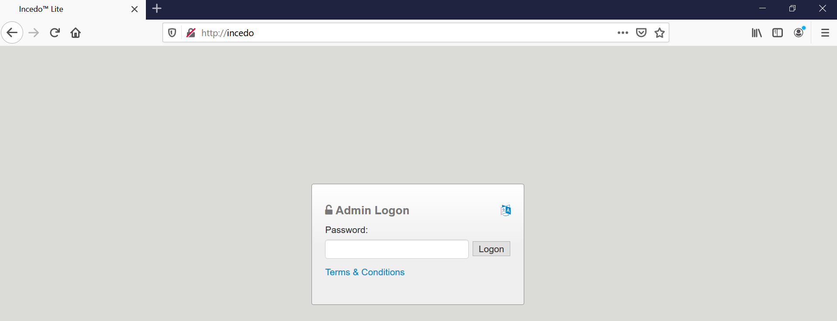
Incedo™ Lite
Software Configuration
Compatible browsers Google Chrome, Mozilla Firefox, Microsoft Edge and Apple Safari
Enter the URL http://incedo/ or IP address 192.168.100.1 into the browser address bar
Default password 12345
12345
V040521

Slide 26
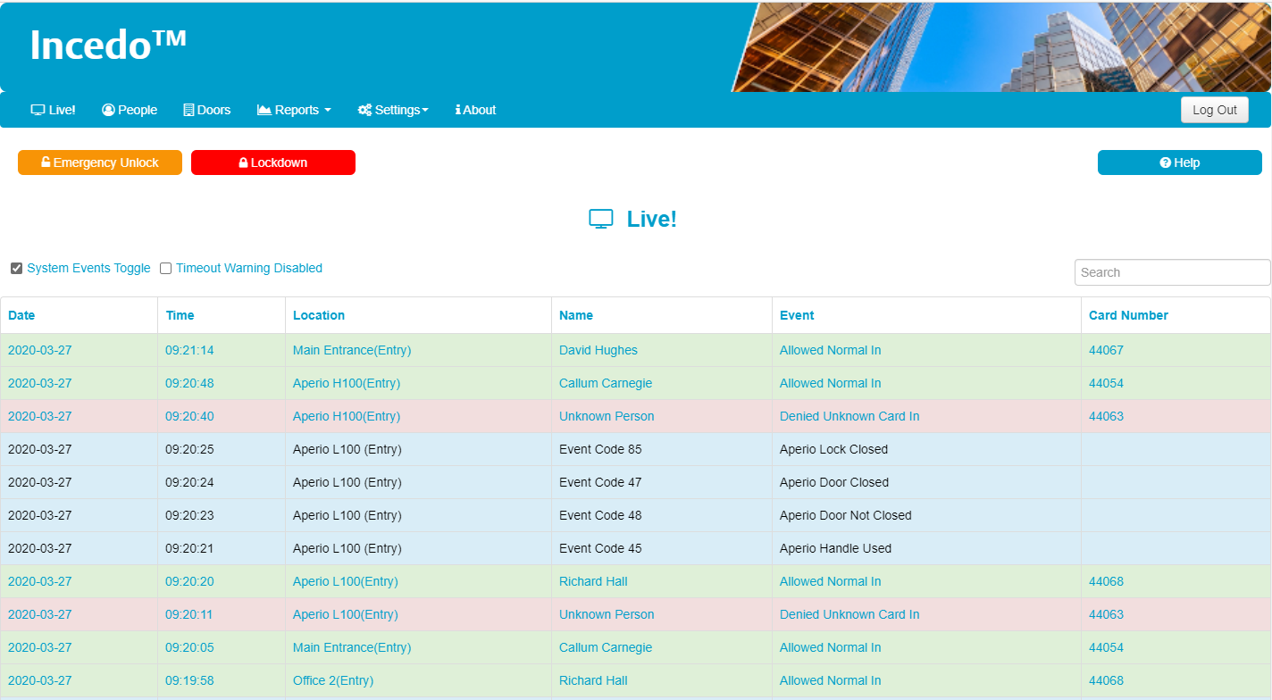
Live!
Incedo™ Lite
V040521

Slide 27
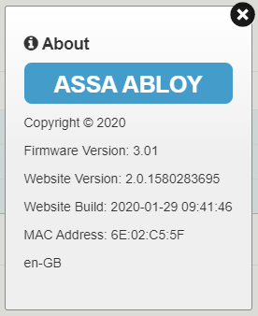
Incedo™ Lite
About
Application details including Firmware version and Build.
V040521

Slide 28
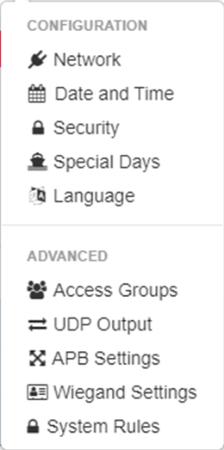
Incedo™ Lite
Settings
Network Settings (slide 26)
This will synchronise the Date and Time with the PC
Change Password
Specify Exception days in Calendar for use in schedules
Select the Language
User/Door Access Groups (slide 32)
Use to stream Event output to third party system
Anti Passback settings
Wiegand Reader/Credential format
Logic Functions
V040521

Slide 29
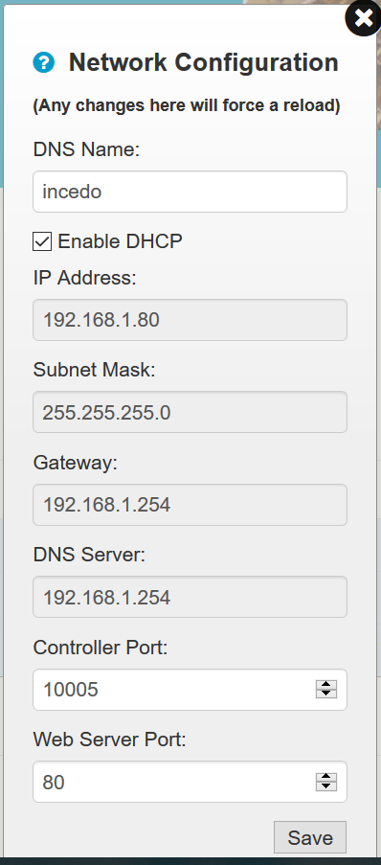
Incedo™ Lite
Network Settings
Choose the Settings Tab Network option from the Settings menu
The default setting is DHCP
The details show the current Network Configuration
To Configure the system to use a Static IP address untick DHCP
If you are unsure of the network setting please contact the Customers I.T department.
V040521

Slide 30

Incedo™ Lite
Settings Configuration
From the Settings TAB
Date & Time: This will synchronise with the PC.
Security: Change the Login Password
Special Days: Additional day type. Add holidays to the calendar.
Language: Select UI language
V040521

Slide 31
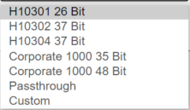
Settings Advanced
Incedo™ Lite
Access groups: User/Door Access Groups (See slide 37)
UDP output: Used to stream Event output to third party system
APB Settings: Anti Passback settings Strict or Relaxed.
Wiegand Settings: Wiegand Reader/Credential format. Default H10302
System Rules: Logic Functions. System event to trigger a relay.
V040521

Slide 32
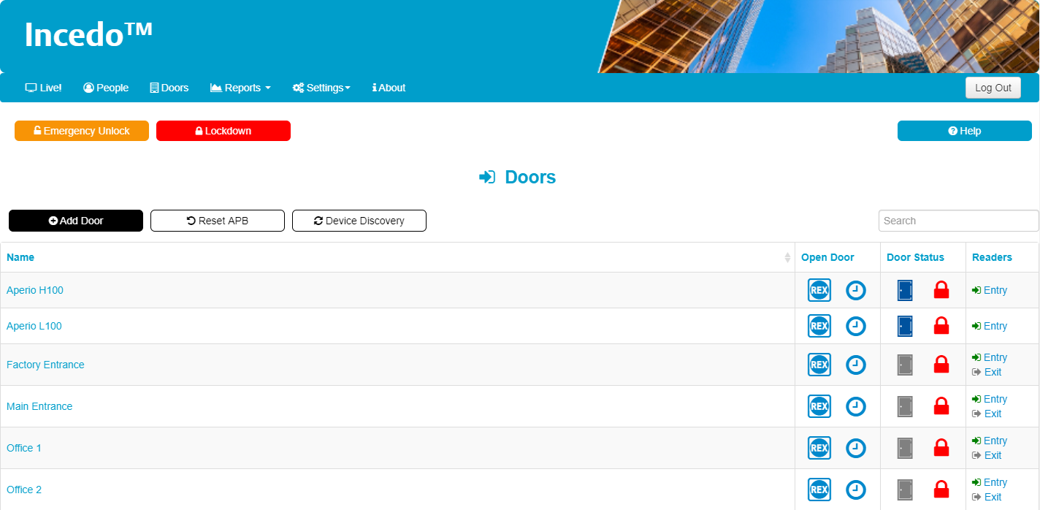
Incedo™ Lite
Doors
V040521

Slide 33
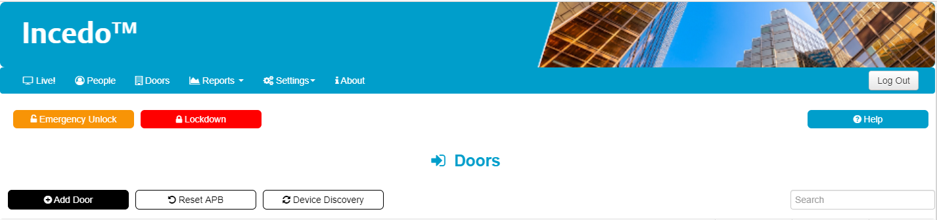
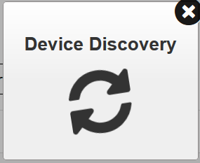
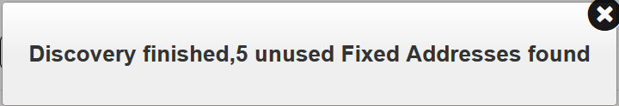
Incedo™ Lite
Adding Doors
To Establish a list of available doors Click Device Discovery
The Device discovery graphic will appear followed by the number of available doors
V040521

Slide 34

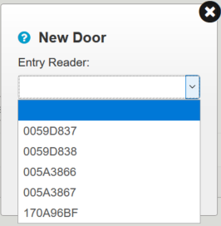
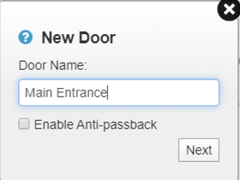
Incedo™ Lite
Adding Doors
Add Door
Name Door
Select the Device address.
ASSA ABLOY Door reader
Address found on reader Module relay or product Sticker.
Aperio devices
Address found in the Aperio programming application
V040521

Slide 35
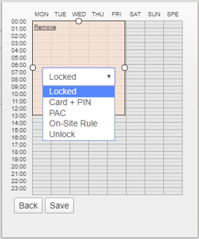
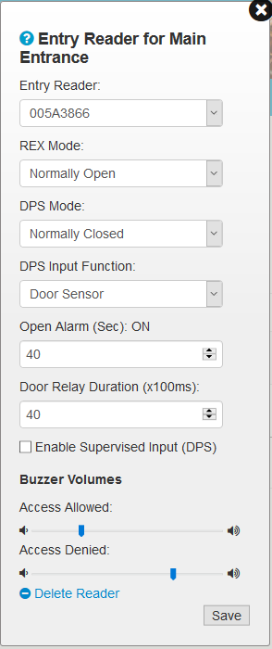
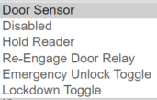
Adding Doors
Incedo™ Lite
Setting up the Door mode
Locked: Sets the door to a locked state where no users are granted entry.
Card and PIN: A credential and Pin number is required for access*
PAC: Personnel access code. This requires the credential number to be entered at the reader. Aperio uses Maximum 4 digits. (credential as pin)*
On Site Rule: Set a period of time where the door will remain unlocked only after a user with valid access uses their credential
Unlock: Set a period of time where the door will remain unlocked
Reader Address
Set Request to Exit
Normally open/closed
DPS Options
Door held open alarm.
Door relay time setting.
Enable Supervised Input DPS short circuit detection
Reader Buzzer volume setting
* When Using a keypad reader with the PAC or Card + Pin mode the user must press the # key following the number
V040521

Slide 36
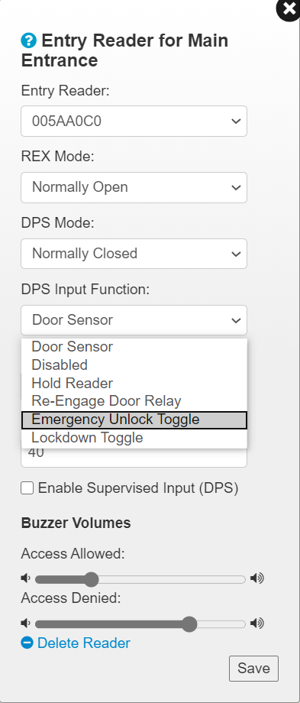
Incedo™ Lite
DPS Input Function
Changing the DPS input function makes it possible to change the system behaviour with an external input for example a relay or switch.
Door Sensor Door position information Open/Closed
Disabled Switch off the DPS input
Hold Reader Access Denied for all users
Re-Engage Door Relay Immediately lock door
Emergency Unlock Toggle Unlocks all Doors
Lockdown Toggle Initiate Emergency Lockdown
V040521

Slide 37

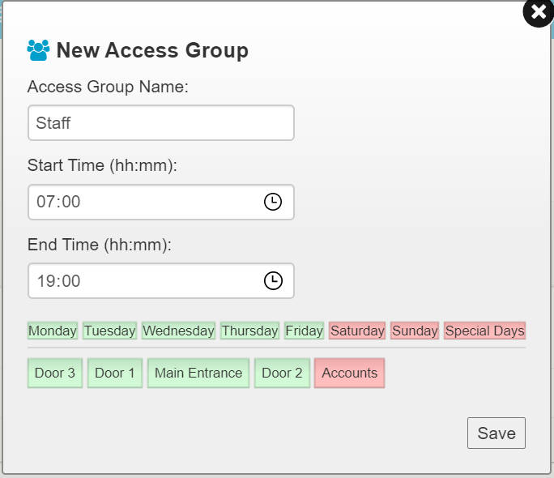
Incedo™ Lite
Access Groups
Create access groups using the Access Groups option from the Settings Menu
This is where we define a users access rights
Name the access group
Often associated with a group of users
Set the time period for when users assigned to the group will have access
Select the doors that users assigned to the group will have access
V040521

Slide 38
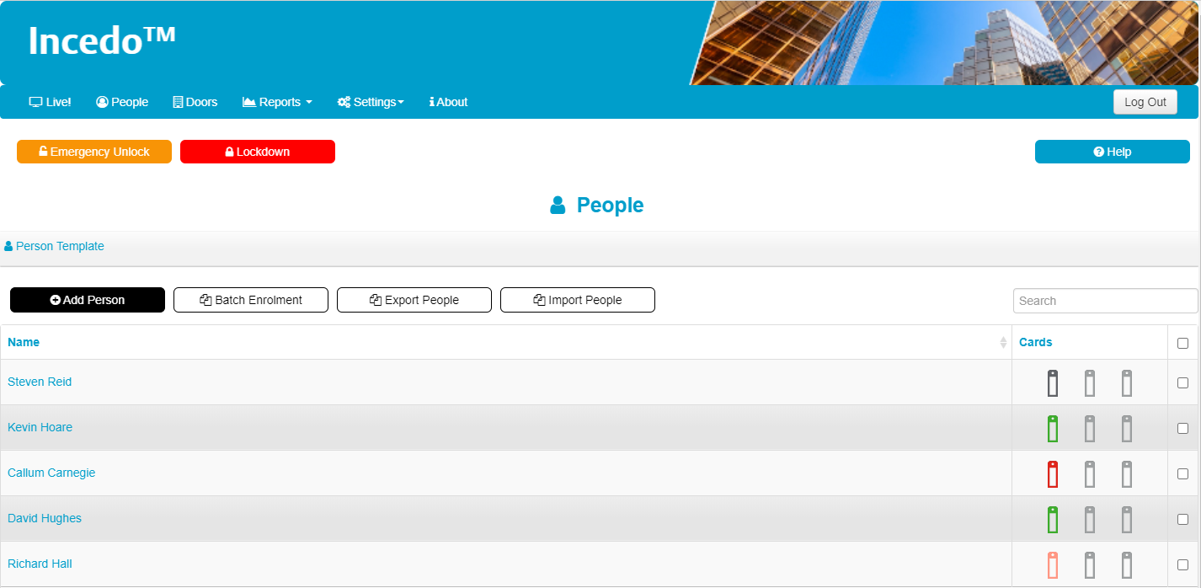
Incedo™ Lite
Users
V040521

Slide 39

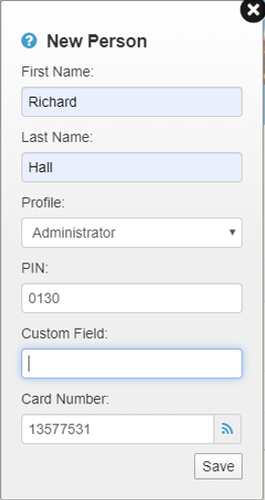

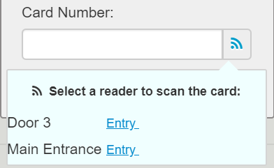
Incedo™ Lite
Adding Users
Card Enrolment
Type card number into Field
Use the Button. Select a reader from the list and present the card
User Name details
Profile: Visitor and Employee used in reporting. A profile of Administrator can Override APB
PIN. Personal pin code used for Door mode Card and PIN.
Custom Field: Description free text.
Card Number: Users credential number.
Use a USB desktop enrolment reader
V040521

Slide 40
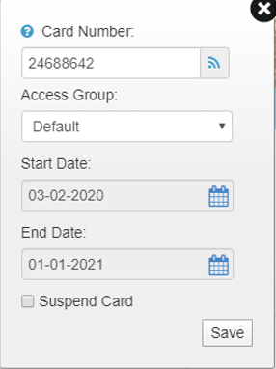

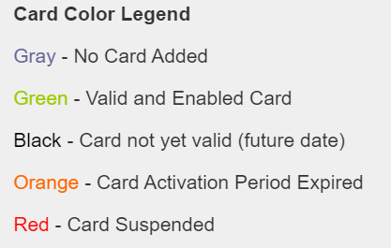
Incedo™ Lite
Adding Users
User Cards
Card enrolment also available by using the button or USB enrolment reader
Access Group. Defines user Access – What doors a user has access to and when. Access groups are defined under the settings menu (slide 34)
If unmodified the default access group allows access to all doors
Start and End Date. The card validity period. When the card will start working and when it will stop
Suspend card. Temporarily block a card
V040521

Slide 41
Incedo™ Lite
Anti Passback -APB
Anti Passback will work across a single system (site), a controller and slaves controllers.
Doors are not set to APB by default, they need to be enabled for APB in the door configuration.
Only Doors enabled for APB will follow APB rules.
Users with a profile of Employee or Visitor will follow APB rules. Users with an Administrator profile are exempt.
If communication is lost between controllers. Readers connected to Slave controllers will continue to function although they will no longer follow the APB rules.
V040521

Slide 42
Incedo™ Lite
Anti Passback
Strict Control
Toggle single entry and single exit function. APB readers only.
  After an entry/in reader is used an exit/out reader must be used before an entry/in reader can be used again.
  After an exit/out reader is used an entry/in reader must be used before an exit/out reader can be used again.
Relaxed Control.
Toggle single entry and multiple exit function. APB readers only.
  After an entry/in reader is used an exit/out reader must be used before an entry reader can be used again.
  Any number of exit/out events can occur without reusing an entry/in reader.
V040521

Slide 43
Incedo™ Lite
LockDown
Use the Lockdown button from the UI or use the Door Position Sensor (DPS) input as a trigger
If you initiate a lockdown it will do two things.
Lock all doors that are following an open schedule.
Deny access to all users on all doors. i.e. all readers/access is blocked.
If you initiate a lockdown using a physical input you can only reset by using the physical input. The software will not allow you to revert to a normal state.
The physical input uses a DPS input so if you have a read in/out door you can use the spare DPS input.
If you are only using read in doors then you will either need to sacrifice a reader port or at least steal the DPS input from that door.
V040521

Slide 44
Incedo™ Lite
Emergency Unlock
Use the Emergency Unlock button from the UI or use the Door Position Sensor (DPS) input as a trigger
If you initiate an Emergency Unlock all doors will immediately Unlock
If you initiate an Emergency Unlock using a physical input you can only reset by using the physical input. The software will not allow you to revert to a normal state.
The physical input uses a DPS input so if you have a read in/out door you can use the spare DPS input.
If you are only using read in doors then you will either need to sacrifice a reader port or at least steal the DPS input from that door.
V040521

Slide 45
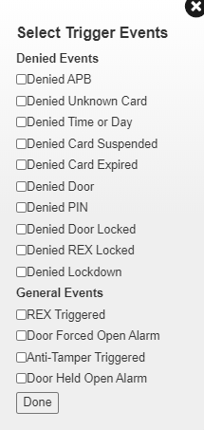
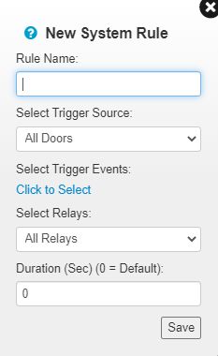
Incedo™ Lite
System Rules
A system rule allows a System Event to trigger one or all door relays for a set duration
Trigger Source – The door related to the Trigger Event
Trigger Event – The required Event to trigger the relay to change state
Relay – The door relay that will change state
Duration – The length of time the before the relay resets
V040521

Slide 46
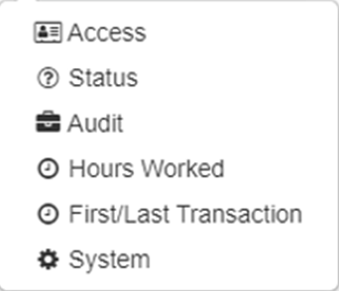
Incedo™ Lite
Reports
Door Events
Hardware Status
Changes made to the software
Available when using APB
Shows the first and last user door event. Requires Entry Exit readers
Hardware repot showing devices attached to the system
V040521

Slide 47
Incedo™ Lite
Q&A
V040521

Slide 48
Thank you
assaabloy.com
V040521

